Slide 1
Google Sign-In for Android
Indra Azimi, S.T., M.T.
D3 Teknik Informatika, Telkom University

Slide 2
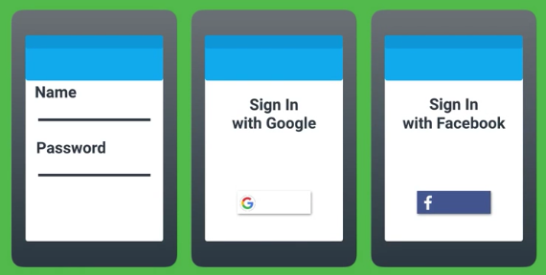
GOAL: Sign-In Made Easy

Slide 3
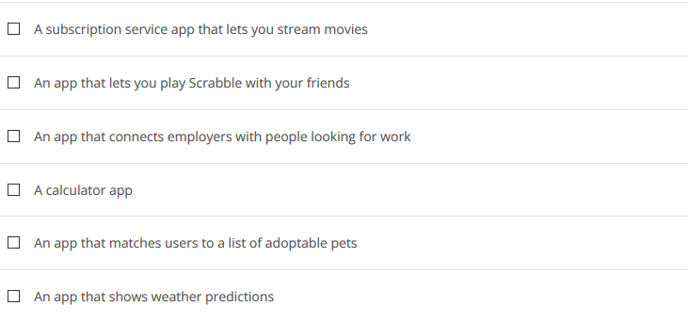
Why Authenticate?
Authentication provides a means of identifying who your users are.

Slide 4
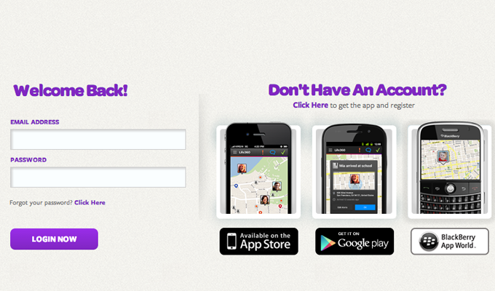
Sign-In Design patterns
3
4
Logout
2
5
Delete account
1

Slide 5
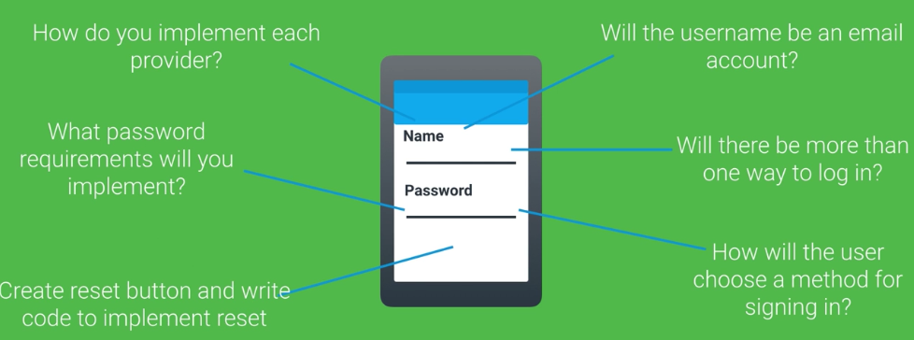
Adding Sign-In: Front-End

Slide 6
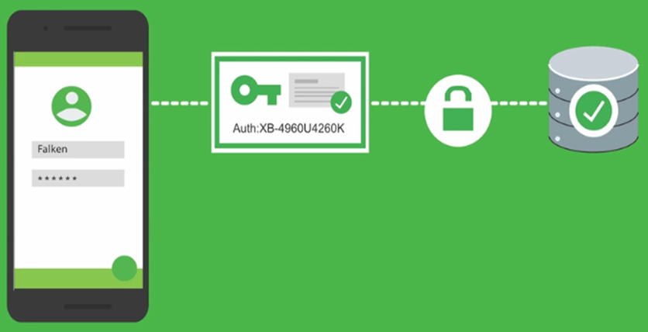
Adding Sign-In: Back-End
Sign-in common issue:
Secure connection (HTTPS)
Reliable server
Efficient script/code
Database management
Etc..

Slide 7
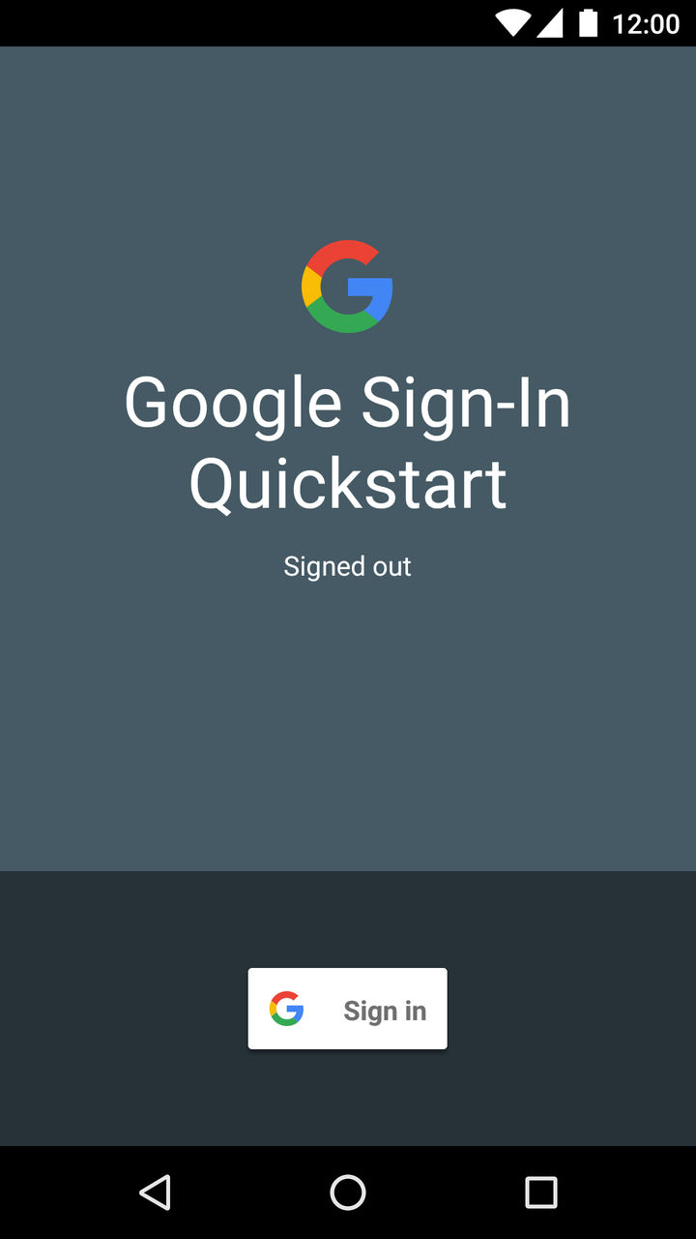
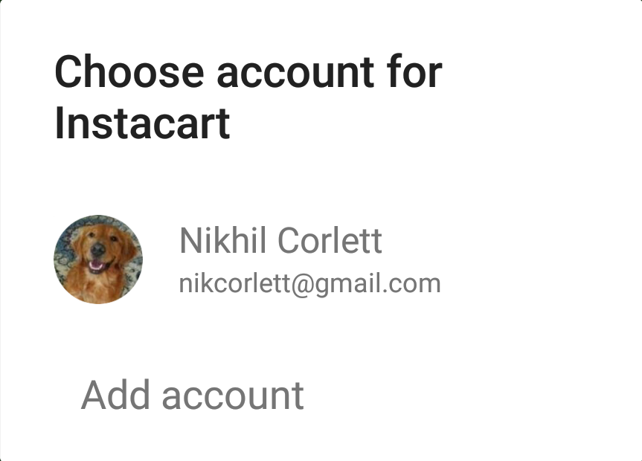
Google Sign-In
Get users into your apps quickly and securely, using a registration system they already use and trust — their Google account.
Example code:
https://goo.gl/yim9dS

Slide 8
CONFIGURATION
Generate & download configuration file
Build.gradle config

Slide 9
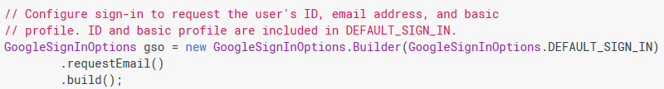
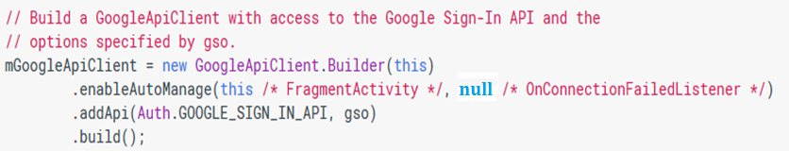
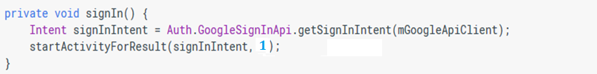
start the sign-in intent

Slide 10
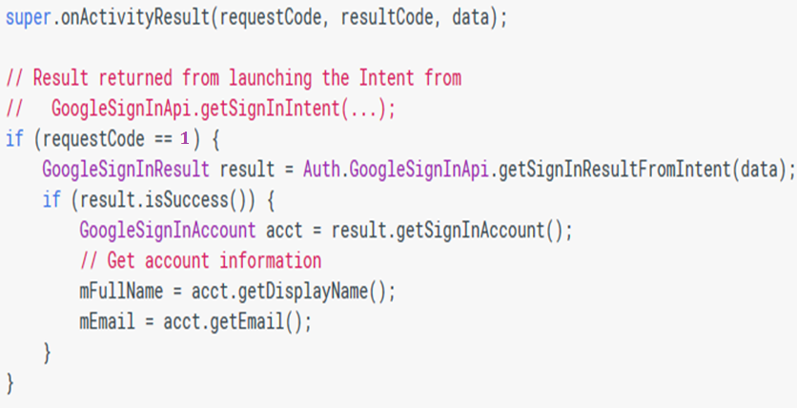
handle the activity result

Slide 11
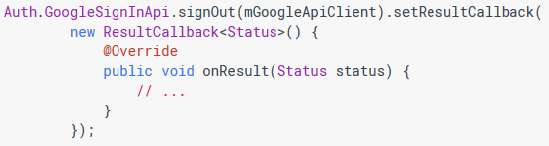
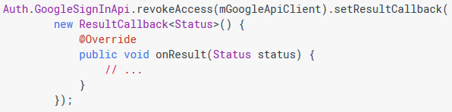
Sign-Out vs Revoke-Access

Slide 12
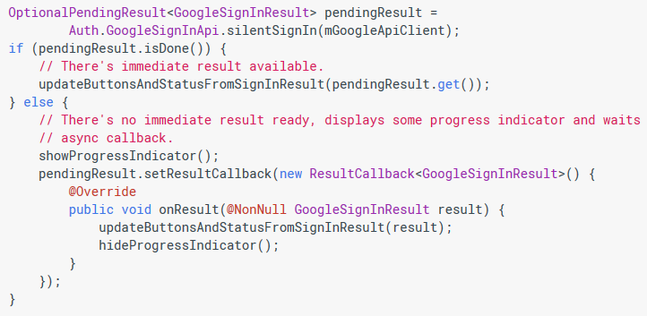
silent Sign-In

Slide 13
Referensi
Lesson 1: Saturday
Firebase in a Weekend (Android)
https://www.udacity.com/course/ud0352
Try Sign-In for Android
https://developers.google.com/identity/sign-in/android/start

